Slide 1


Ultimate Concern Tracking and Response Mechanism
MERN-stack grievance portal streamlines grievance management with user/admin logins, submission and tracking, automated resolution emails, and petition support, allowing creation, editing, deletion, and upvoting.
Mentor – Prof. Puneet Kumar Goyal
Aditya Pandey 2100290120017
Apurwa Kumari 2100290120043
Aditya Dwivedi 2100290120016
Akshat Kishore 2100290120023

Slide 2

Project Abstract
Overview
Key Objectives
Approach
The MERN-stack grievance portal enables secure, role-based grievance submission and tracking, with automated notifications and a petitions feature for interactive user engagement.
Centralize grievance handling, improve transparency, and ensure timely communication with automated notifications to streamline grievance resolution and enhance user-administration interactions.
Developed using MERN, the portal employs secure authentication, Nodemailer for automated updates, and Tailwind CSS for a responsive interface, supporting user actions on grievances and petitions.

Slide 3

Project Goals and Objectives
Streamline conflict resolution processes through an intuitive online portal that enables confidential grievance reporting and progress tracking.
1
Increase transparency in the grievance resolution process by providing employees with visibility into the status of their complaints and the actions taken to address them.
2
Create a safe space for individuals to discuss and address mistreatment, unfair practices, and policy violations, fostering transparency, accountability, and a culture of respect and fairness within institutions.
3

Slide 4
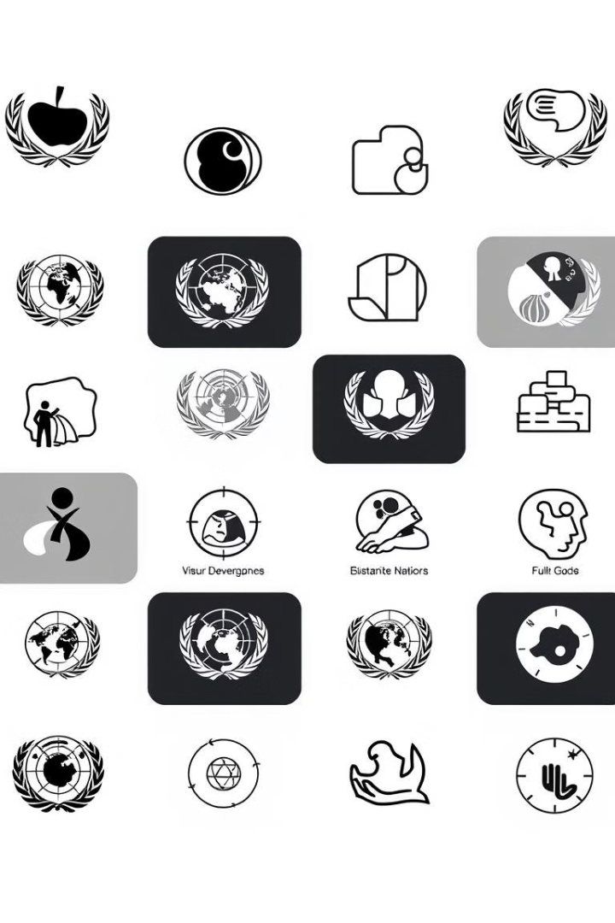
Alignment with UN Sustainable Development Goals (SDGs)
SDG 8 : Decent Work and Economic Growth:
SDG 16: Peace Justice
and strong institutions
The system makes the process of grievance disposal more efficient and productive by taking less time and effort, hence allowing employees and students to get back to work without being continuously interrupted.
Promote peaceful and inclusive societies for sustainable development, provide access to justice for all and build effective, accountable and inclusive institutions at all levels.

Slide 5





Methodology and Approach
MERN Stack Implementation
Utilized MongoDB, Express, React, and Node.js to build a scalable and efficient web Application. React powers the frontend, while Express and Node handle the backend logic.
Secure Authentication and Role-Based Access
Implemented token-based authentication for secure login, with role-based access control that grants specific permissions to users and admins, ensuring data security and streamlined access.
Automated Notification System
Integrated Nodemailer to send automated email notifications to users, informing them when their grievances are resolved, enhancing communication and keeping users updated.
Responsive and Modern UI Design
Designed the frontend with Tailwind CSS, providing a responsive, user-friendly interface. This approach ensures an engaging experience across devices and improves user interaction.

Slide 6
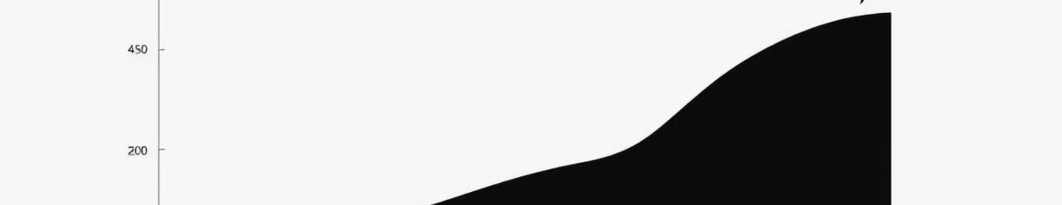



Expected Outcomes and Impact
Improved Grievance
Management Efficiency
Enhanced User
Experience and Engagement
Increased Transparency
and Accountability
The portal centralizes grievance tracking and resolution, allowing admins to manage cases effectively, reducing response time, and enhancing overall grievance-handling efficiency.
A modern, responsive UI combined with automated email updates keeps users informed and engaged. The petitions feature fosters community involvement, allowing users to support causes easily.
By providing visibility into grievance statuses and automated notifications, the portal promotes transparency and builds trust, ensuring users feel heard and valued throughout the process.

Slide 7

Key Project Deliverables
User and Admin Authentication
System
Grievance Submission and
Tracking Module
Admin Dashboard and Grievance
Management
Automated Email Notifications
Petitions Feature with User
Interactions
Responsive Frontend

Slide 8

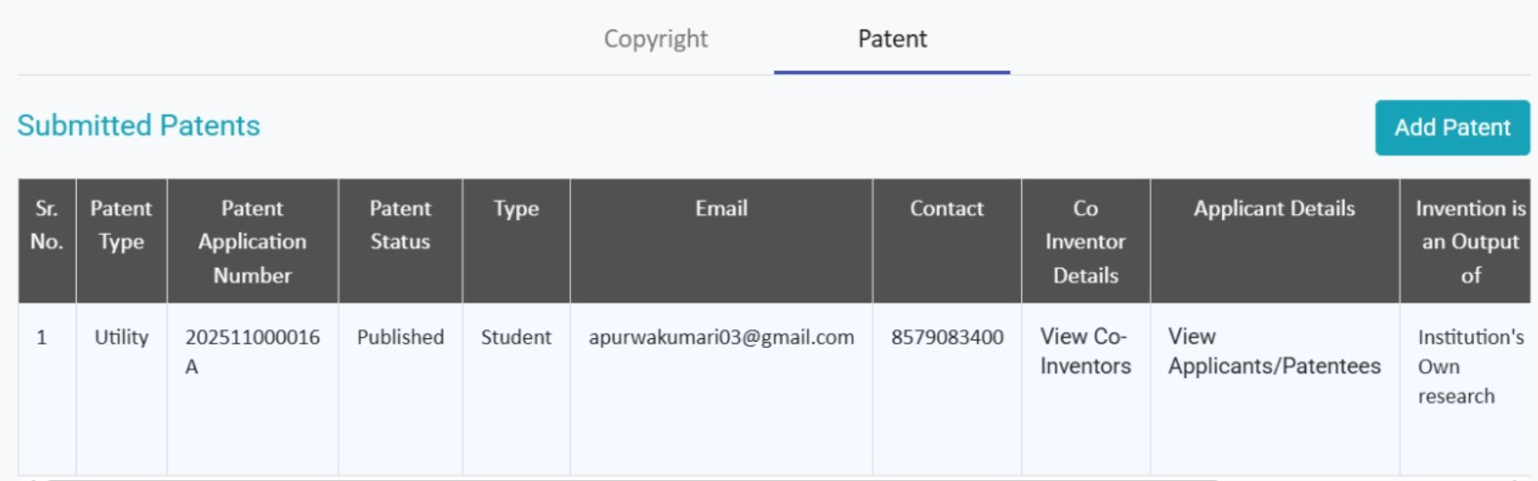
Patent Status

Slide 9

Next Steps and Conclusion
User Feedback and
Iterative Improvement
Enhanced Admin
Analytics and Reporting
1
2
Gather feedback from initial users to identify areas for improvement, refine features, and address usability challenges.
Implement analytics for admins, providing insights into grievance resolution times and trends, helping streamline processes and improve service quality.
3
Mobile Application Development
Expand accessibility by developing a mobile app version, ensuring users can submit and track grievances on-the-go.

